Slide 1
Analysis of Employees’ Feedback Using Sentimental Analysis
Group Name: Trackers
Sai Poorna Chowdary Dama
Poojitha Dundi
Jyothi Modugula
Kalpana Takkellapati

Slide 2

Abstract
Goal, to analyze the employee evaluations of an organization.
It’s difficult to hone in on employee sentiment no remember what size the organization, however large, complex establishments have a unique challenge.
Sentiment analysis software program takes a seem at all worker survey responses and shortly determines the “why” behind the engagement ratings.
Lexicon Based approach is used.

Slide 3

DATA SET
Collected a large set of employee reviews from glass doors, indeed, LinkedIn and various other sources of Amazon.
Dataset consists of upto 45000 reviews from various resources.
Reviews are easily available but cannot download directly.
To scrap the data a readymade tool called “web harvy ” is being used.

Slide 4

Data Explanation
Web Scrapped the whole data into the sentence level type, which is of around 45,000 reviews.
Where each sentence is analyzed.
Prepared as text corpus and is given as input to our programme.

Slide 5
Approach
Since it is the text corpus and un-labelled data, found it with solving through Lexicon based approach.
An external dictionary is being used.
NRC(Emotion Lexicon)

Slide 6
Process of SA
Text Preprocessing
Feature Extraction
Sentiment
Lexicon
Text Dataset
Stop word removal
Yes
Stemming
Subjective?
Sentiment Classification
No
Tokenization
Discard
Negation Handling
Sentiment Polarity

Slide 7
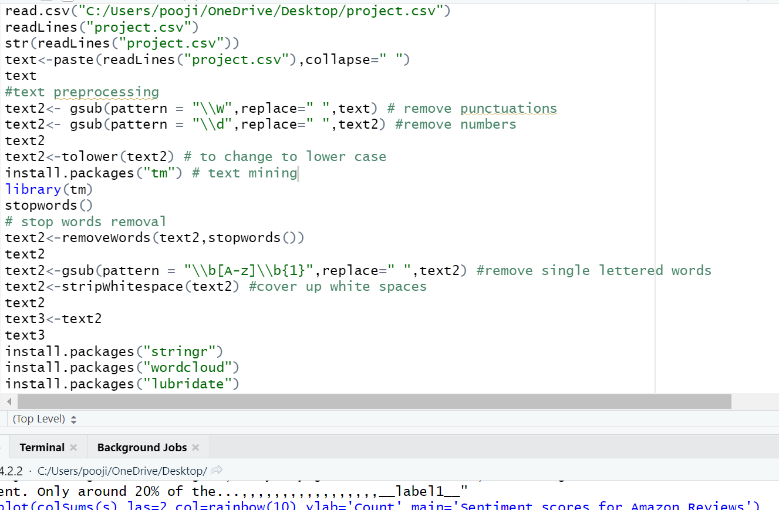
Text Preprocessing

Slide 8
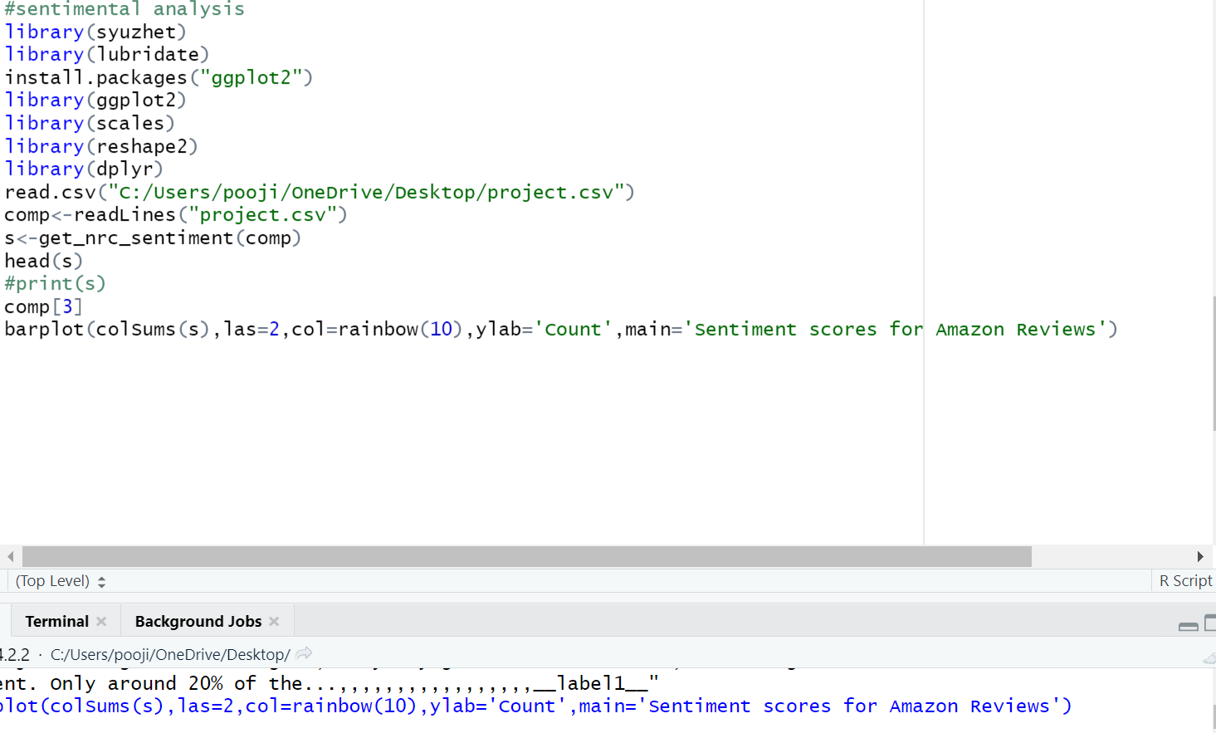
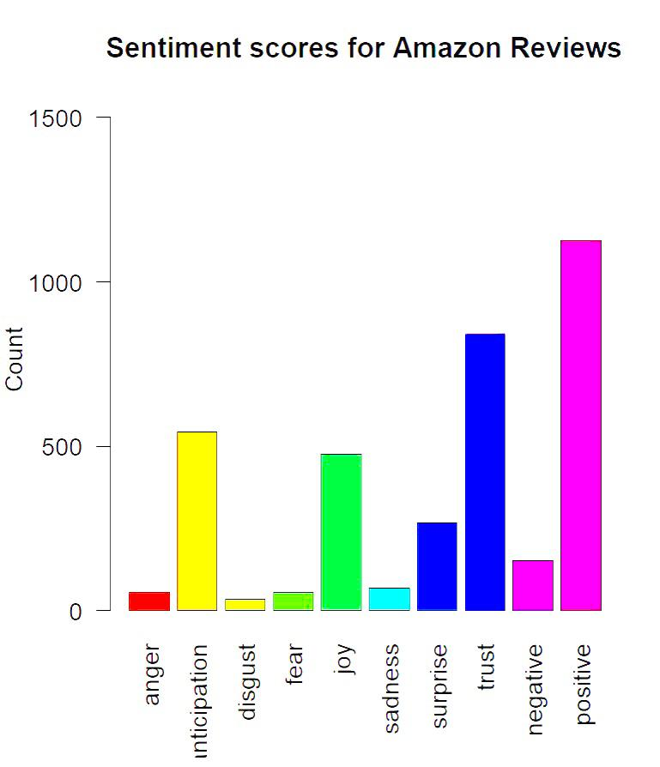
NRC Emotion Lexicon

Slide 9
Vader Sentimental Analysis
VADER (Valence Aware Dictionary and Sentiment Reasoner) is the lexi and it is rule-based tool.
That’s mainly reflected the opinions expressed in media.
Uses a lexicon-based approach to determine the sentiment of a piece of text.
where the sentiment score of each word is calculated based on its polarity.

Slide 10
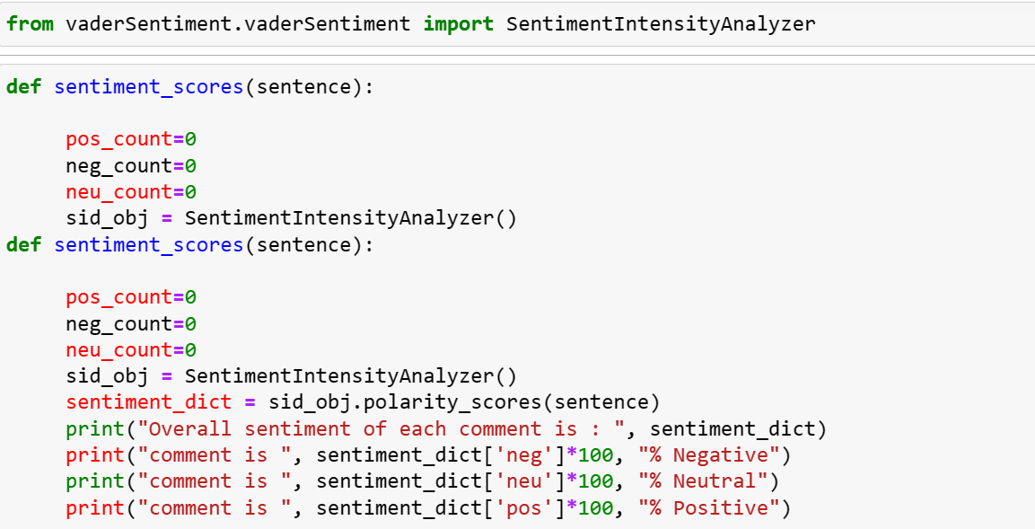
Implementation

Slide 11
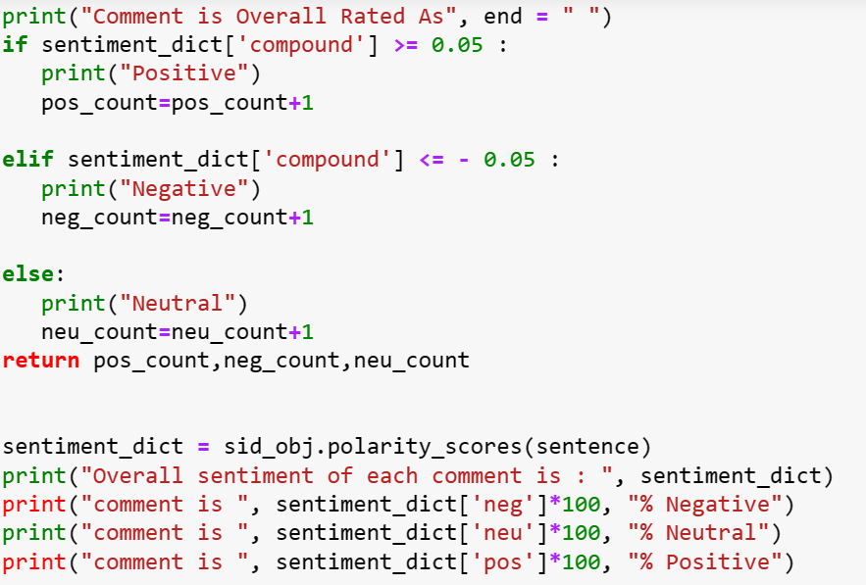
Implementation

Slide 12
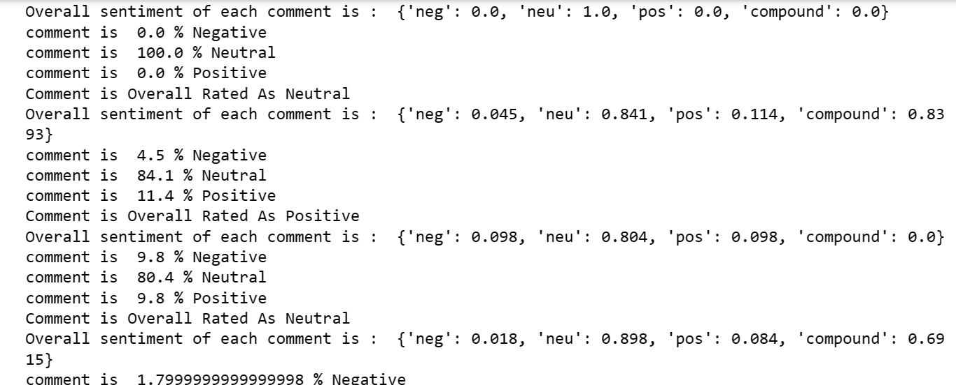
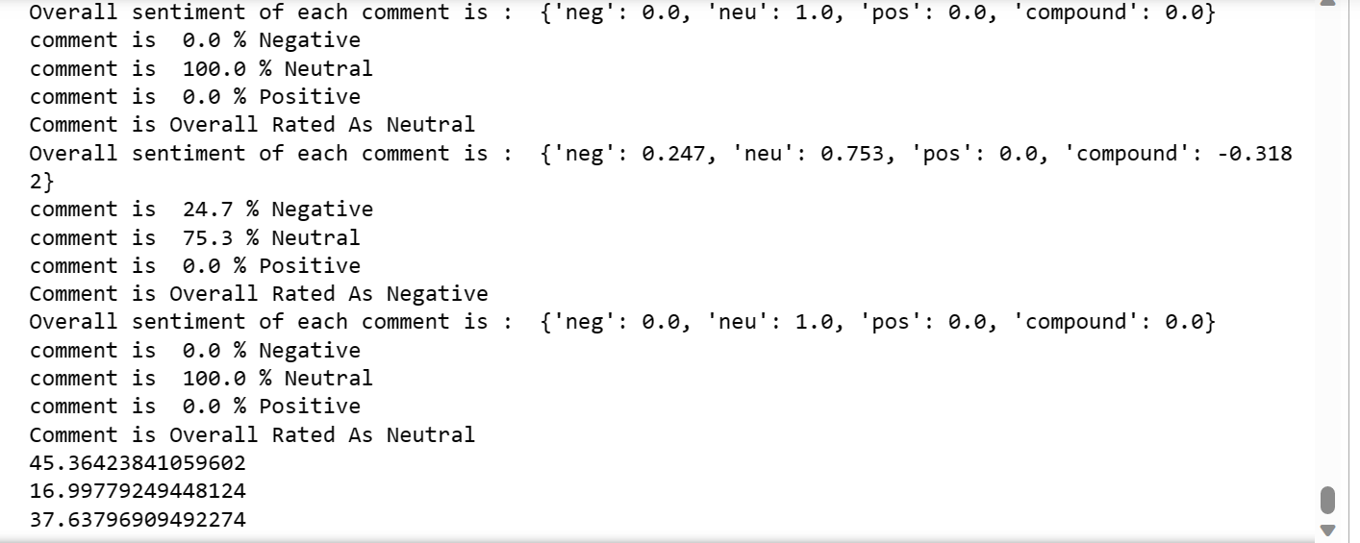
Results

Slide 13
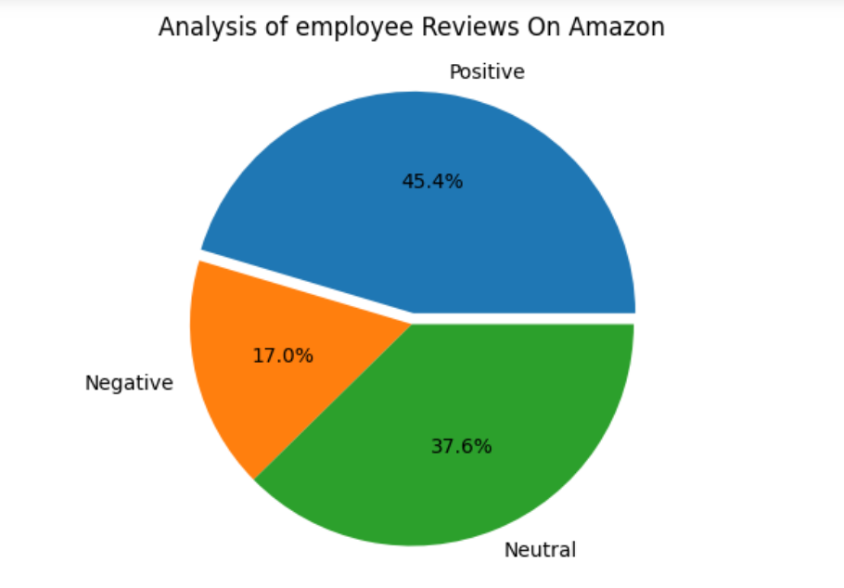
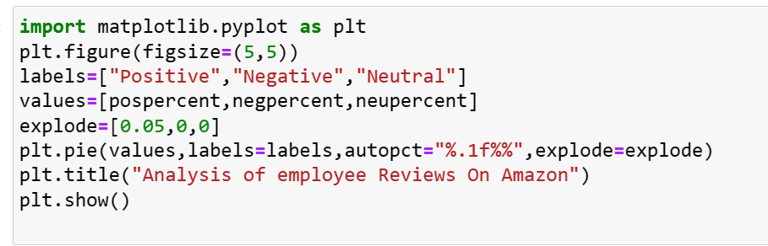
Results

Slide 14
References
Pang B, Lee L. , “Opinion mining and sentiment analysis” Found Trends Inform Retriev:1–135, 2020.
Pang B, Lee L. , “Opinion mining and sentiment analysis” Found Trends Inform Retriev:1–135, 2021.
Improved lexicon-based sentiment analysis for social media analytics Jurek, M Mulvenna & Yaxin . Bi Security Informatics volume 4 (2015).

Slide 15
THANK YOU

